Slide 1






Sentiment Analysis
From First Principles to Transformers
A comprehensive engineering-driven evaluation of NLP systems comparing classical ML approaches to modern Transformer architectures
Mohammad
#300480272
Master's of Engineering, University of Ottawa
December 2, 2025

Slide 2








Project Goal & Problem Statement
Project Goal
Problem Statement
Conduct a comprehensive, engineering-driven evaluation of NLP systems, comparing methodologies from classical ML to modern Transformer architectures.
Despite widespread adoption of models like BERT and GPT, there's a significant gap in understanding:
Underlying mechanics of NLP systems
Focus on trade-offs between performance and efficiency
Comparison between classical and modern architectures
Systematic comparison of diverse architectures
Engineer challenges in optimizing for constrained hardware
Analysis under real-world engineering constraints
"Addresses this with end-to-end empirical analysis of NLP architectures"
2/13

Slide 3


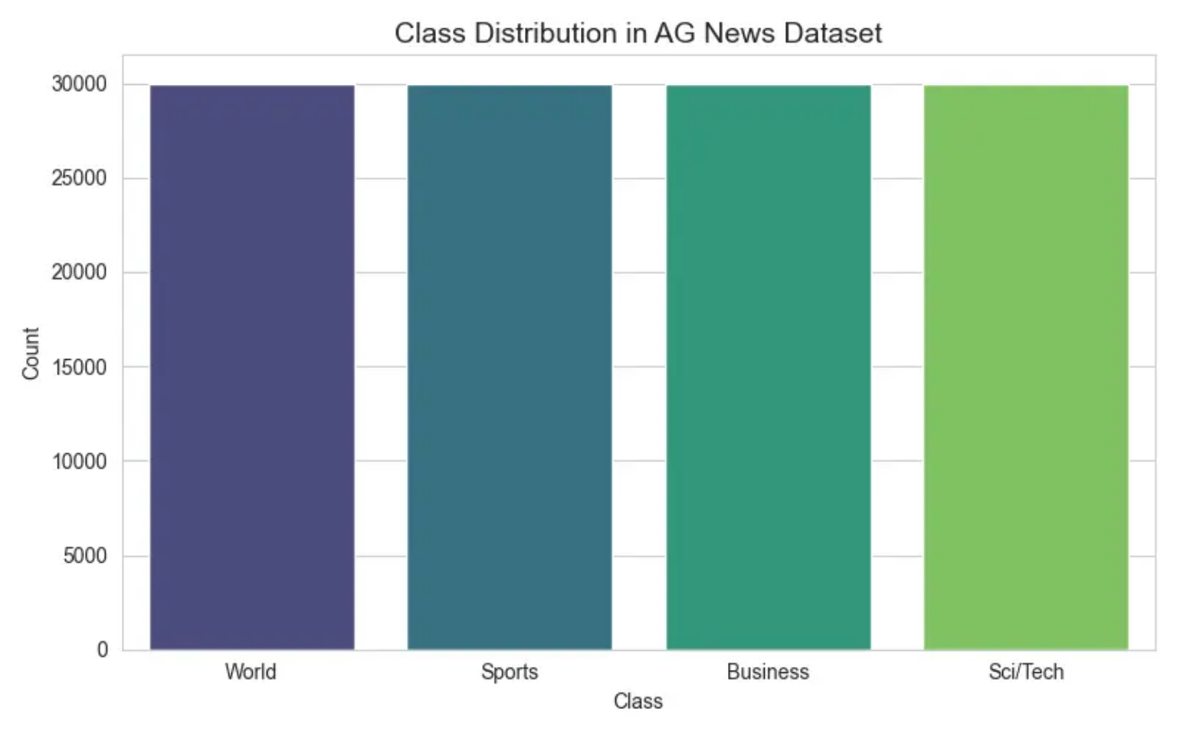









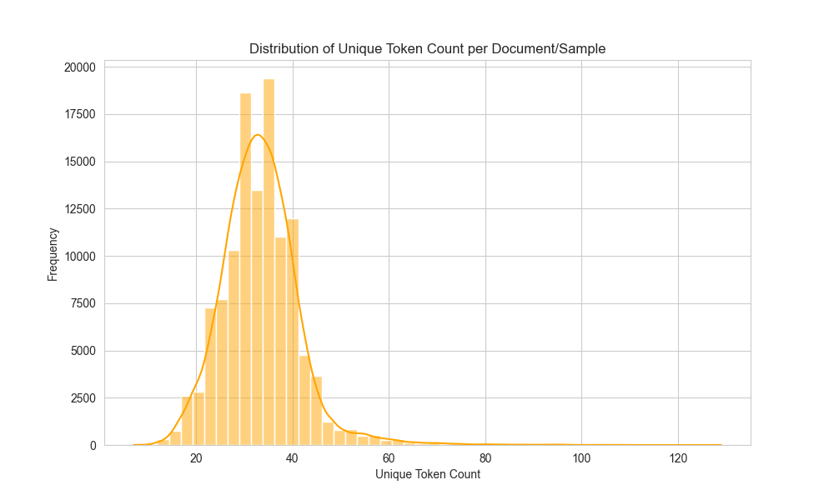




Dataset Overview - AG News Corpus
Key Dataset Characteristics
Class Distribution
Task
4-class topic classification
World, Sports, Business, Sci/Tech
Size
120,000 training samples
7,600 test samples
Balance
Equal number of documents per class
Document Length
Average of 37.85 words
The AG News dataset contains 4 classes: World, Sports, Business, and Science/Technology.
3/13

Slide 4











Classical Machine Learning Approaches
Feature Extraction
Classical Models
Bag-of-Words (BoW)
Logistic Regression
CountVectorizer for 5,000 unigrams
Linear classifier
Foundation of information retrieval
Efficient on linearly separable data
Sparse vector representation
Random Forest
TF-IDF
Ensemble of decision trees
TF-IDF vectorizer with 1-2 grams
Captures non-linear relationships
Max 5,000 features
Weighted document vectors
XGBoost
Gradient-boosted decision trees
Enhanced performance over Random Forests
4/13

Slide 5


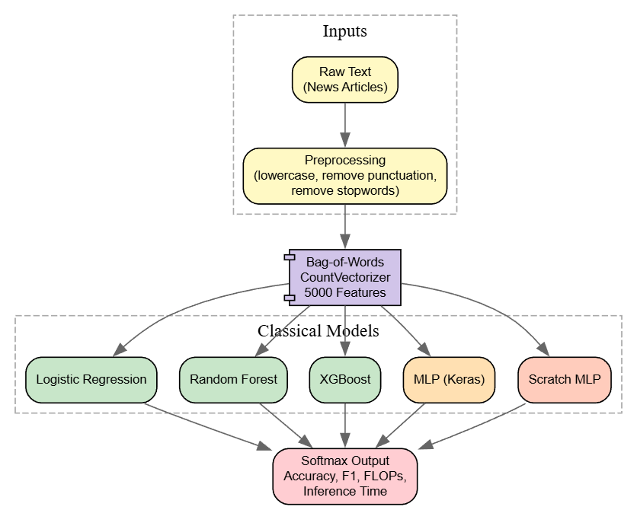
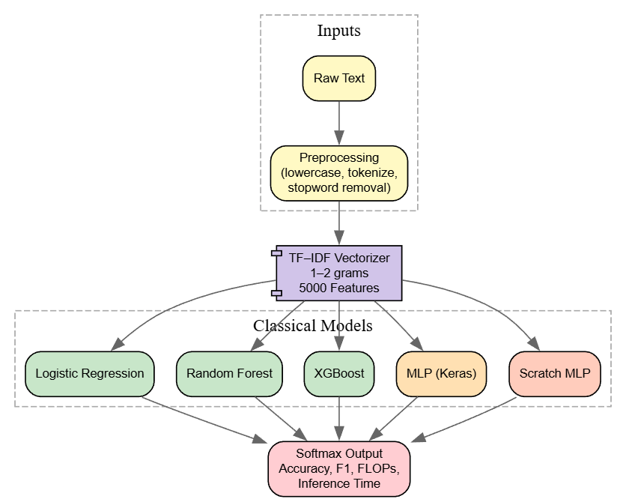
Workflow
Figure: Bag of Words Vectorizer Workflow for different Models
Figure: TF-IDF Vectorizer Workflow for different Models

Slide 6




















Embedding-Based Deep Learning Models
Neural Networks as First Principles
Word2Vec Embeddings as First Principles
First principles of representation learning through neural embeddings with 100-300 dimensional learnable vector spaces for contextual text.
Specialized implementation of word vectorization first principles with CBOW or Skip-gram, mapping 100-300 dimensional text concepts into semantic dense vectors.
Token Indices
Embedding Layer
Aggregation
Neural Classifier
(Pooling)
100-300 dims
CNN/MLP
Text Input
Word2Vec Model
Word Vectors
Neural Classifier
100-300 dims
CBOW/Skip-gram
CNN/MLP
Captures semantic relationships between words
Learnable parameters specific to the task
Uses pre-trained embeddings from large corpora
Combines well with CNN and MLP classifiers
5/13

Slide 7






















Transformer Architecture - BERT Fine-tuning
BERT-base-uncased
Fine-tuning Configuration
12-layer, 768-hidden, 12-heads
AdamW optimizer
Lowercase tokenizer
Learning rate: 1e-5
WordPiece vocabulary
3-5 epochs
BERT Fine-tuning Pipeline
Input Text
BERT Encoder
[CLS] Token
Classification Head
Tokenized using WordPiece
Processes tokenized inputs
Extraction of first token
MLP with softmax output
BERT advances first principles methodologies with multi-headed self-attention, refining attention maps, and pooling embeddings to capture context beyond simple bag-of-words representation
6/13

Slide 8









Evaluation Metrics Framework
Predictive Performance
Computational Efficiency
Accuracy
Training Time
Overall classification correctness measured as the ratio of correctly classified samples to total samples.
Measured in seconds, representing the wall-clock time to train the model on the training dataset.
F1-Score
Inference Time
Weighted average of precision and recall across the four classes, providing balance between true positives and false positives.
Average time per test sample in seconds, measuring the model's prediction speed.
FLOPs per Sample
Floating Point Operations per second, measuring the computational complexity of the model.
7/13

Slide 9
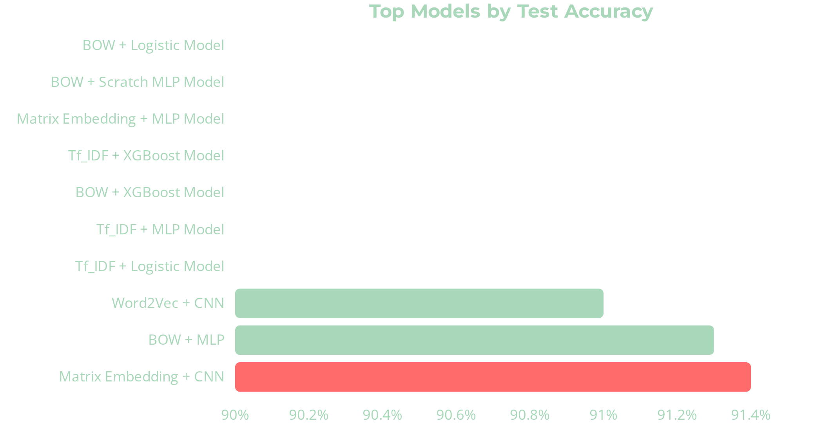









Performance Results Overview
Top Performers
Matrix Embedding + CNN: 91.4% accuracy
BOW + MLP: 91.3% accuracy
Word2Vec + CNN: 91.0% accuracy
Key Insights
Neural architectures with embeddings outperform classical methods
MLP models show similar performance to CNNs for this task
Classical models like Logistic Regression lag behind (90.2% accuracy)
8/13

Slide 10




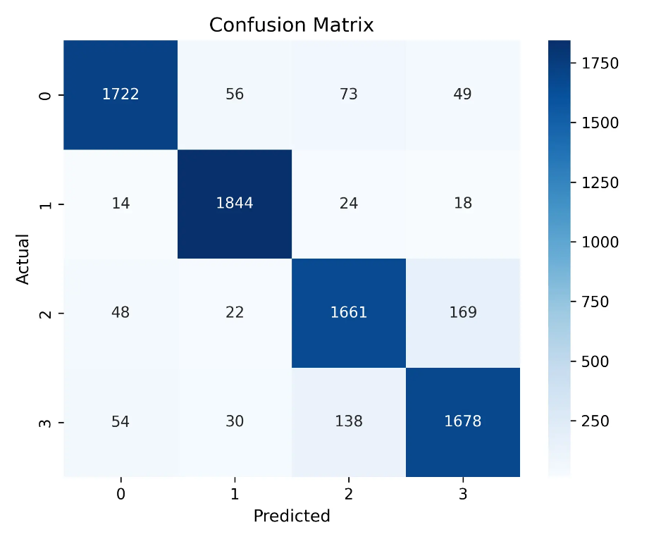


Top Performing Models Analysis
Top Models by Test Accuracy
Confusion Matrix Analysis
Model
Test Accuracy
The confusion matrix for the best-performing model (Matrix Embedding + CNN) reveals:
Matrix Embedding + CNN
0.914
Strong classification performance across all news categories
BOW + MLP
0.913
Mostly accurate predictions with balanced error distribution
Word2Vec + CNN
0.910
Word2Vec model shows slightly better performance (0.893 vs 0.898) on unseen data
Tf_IDF + Logistic Model
0.906
BOW + XGBoost Model
0.905
Key Insight: Matrix Embedding + CNN achieved the highest accuracy (0.914), demonstrating the effectiveness of combining advanced embedding techniques with neural architectures.
Confusion Matrix: Matrix Embedding – CNN Model
9/13

Slide 11


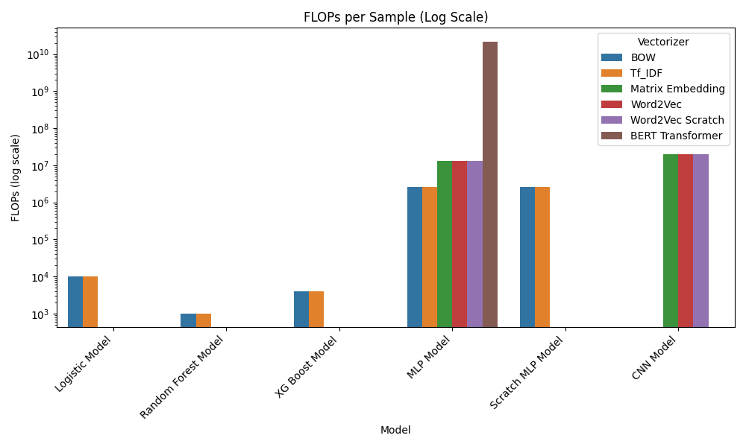




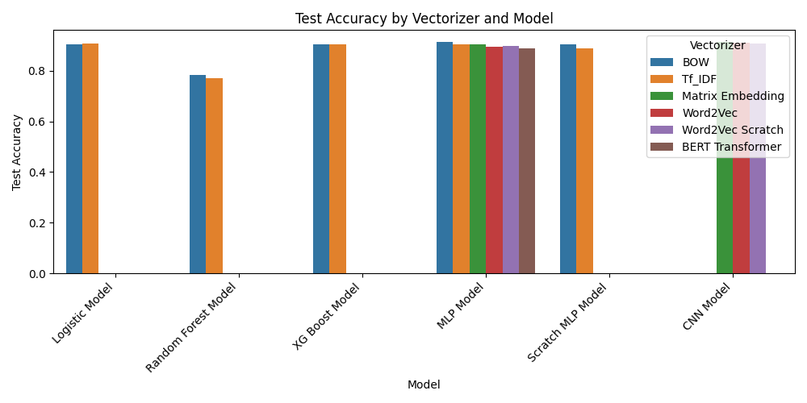
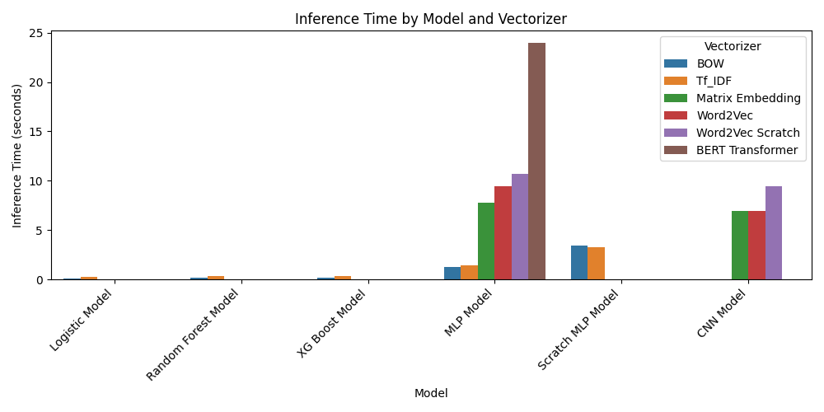



Efficiency & Accuracy Trade-offs
FLOPs Per Model
Key Insights
Efficiency Leaders
Classical models (BOW/TF-IDF + Logistic) offer excellent efficiency with ~90% accuracy
BERT Outlier
BERT has highest computational cost without achieving superior accuracy (0.887)
Optimal Choice Depends
Model selection should be guided by deployment constraints and requirements
Efficiency Metrics
FLOPs per Sample
Training Time (s)
Inference Time (s)
10/13

Slide 12










Key Findings & Insights
Classical Models as Baselines
Best Accuracy-Cost Balance
Model Selection Trade-offs
Logistic Regression and MLPs on Bag-of-Words/TF-IDF features achieve ~90-91% accuracy with significantly lower computational costs.
Matrix Embedding + CNN achieved 0.914 test accuracy while maintaining reasonable balance between accuracy, FLOPs, and training time.
Optimal model choice dictated by interplay between accuracy, computational efficiency, and deployment constraints.
Efficient training and inference
Suitable for real-time deployment
No universal best model
Strong performance on structured data
Effective semantic understanding
Problem-specific optimal choices
Model selection requires balancing accuracy, efficiency, and specific application requirements
11/13

Slide 13




Limitations & Future Work
Limitations
Future Work
Constrained Training Budget
Extended Fine-Tuning Schedules
BERT Transformer model underperformed relative to its known capabilities due to limited training resources.
Extend BERT training epochs from 10 epochs to 40-50 to significantly improve accuracy.
Computational Constraints
Lightweight Transformer Variants
Resource limitations prevented exploration of larger model architectures and longer training schedules.
Investigate MobileBERT, TinyBERT, or DistilBERT for resource-constrained environments.
Larger Label Spaces
Evaluate transformers on tasks with hundreds or thousands of output classes to highlight advantages.
12/13

Slide 14










Thank You
Questions?
Mohammad
Project Repository
Master's of Engineering, University of Ottawa
GitHub
fmoha077@uottawa.ca
https://github.com/mohammad1774/applied_ml_project#
December 2, 2025
Feedback and discussions welcome
13/13

Slide 15
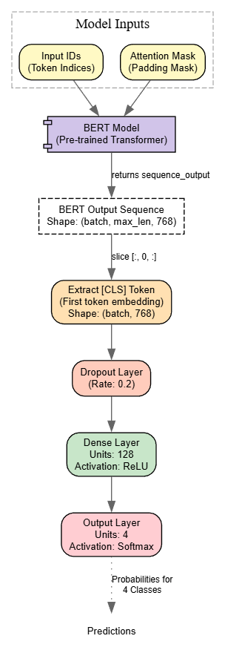
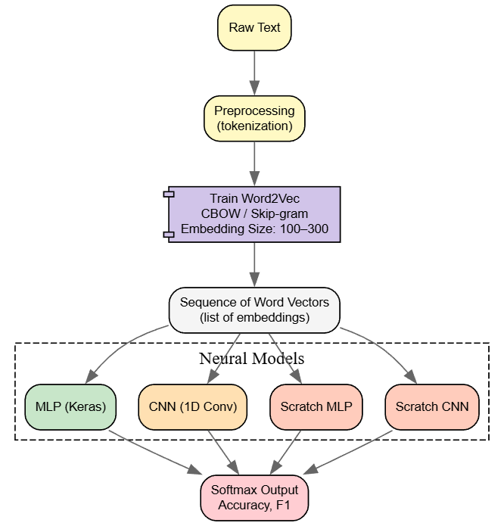
Workflow
Figure: Bag of Words Vectorizer Workflow for different Models
Figure: TF-IDF Vectorizer Workflow for different Models
Figure: BERT with an MLP Classification Layer Models
Figure: Word2Vec with Neural Network Models

